Slide 1
Module 9

Slide 2
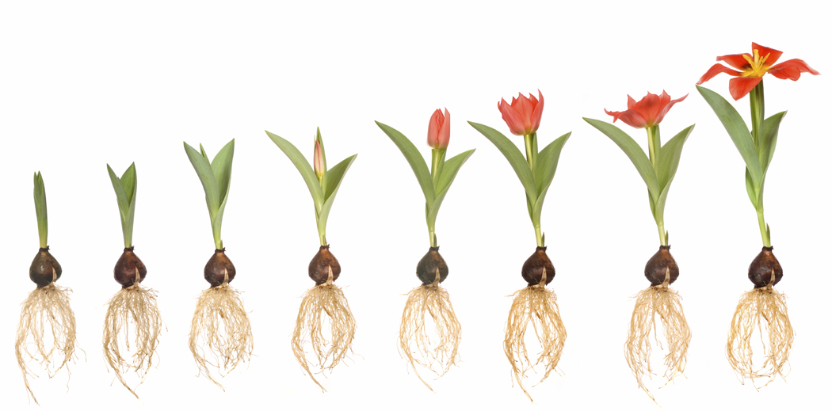
Plant movements are coordinated by HORMONES
There are Four type of plant hormones
1. Auxin
2. Gibberlins
3. Cytokinins
4. Abscissic Acid

Slide 3
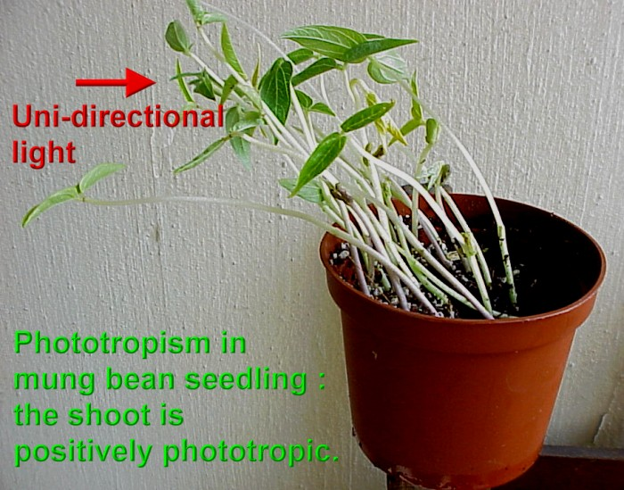
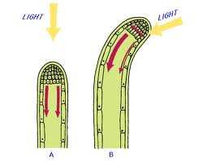
Auxin : Help shoot cells to grow longer

Slide 4
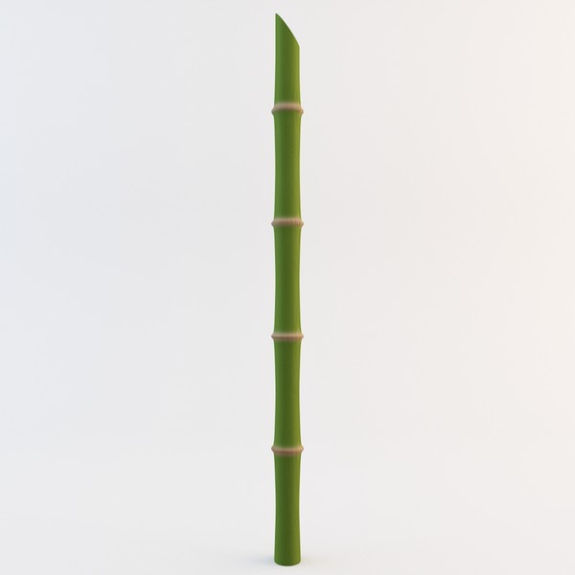
GIBBERELLINS
helps in growth of the stem
Gibberellins
Stem elongates
When gibberellins act on stem

Slide 5
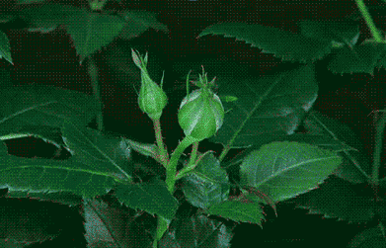
CYTOKININS : Promote cell division.

Slide 6
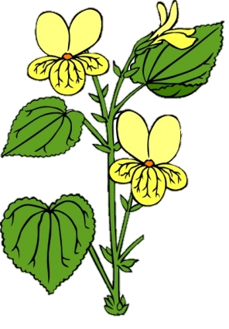

ABSCISSIC ACID : Inhibits growth and leads to wilting of leaves

Slide 7

They lead to growth of the plant
Can you recollect the roles of all the plant hormones ?
Are all the hormones promoting growth ?
AUXIN : Help shoot cells to grow longer
GIBBERELLINS : Help in growth of the stem
Are growth promoters
NO !!!!!
Stops the growth
CYTOKININS : Promote cell division
Growth Inhibitor
ABSCISSIC ACID : Inhibits growth and leads to wilting of leaves

Slide 8
Thank You

